Slide 1
MedicareBot
A presentation by Hackerguys

Slide 2
Team Hackerguys
Name Roll
Ankita Patsa 1830078
Ankush Sinha Roy 1830079
Arpan Mitra 1830083
Uddipan Nath 1830143

Slide 3

Healthtech
The definition of Health Tech, or digital health, is the use of technology (databases, applications, mobiles, wearables) to improve the delivery, payment, and/or consumption of care, with the ability to increase the development and commercialization of medicinal products.

Slide 4


Problem Statement
Create Solutions to deal with these two major challenges faced by the patients:
1. Enabling a patient-centered information exchange system.
2. Personal medical assistant.

Slide 5
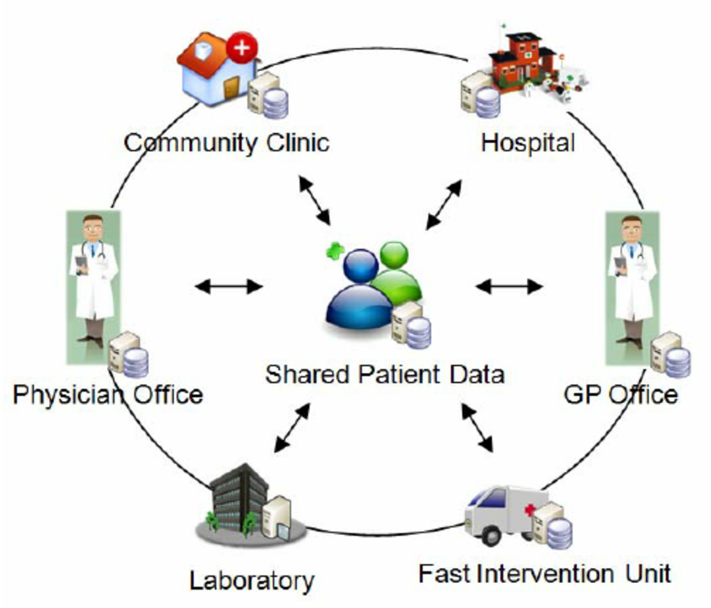
Enabling a patient-centered information exchange system.
Patient-centered information systems augment traditional approaches to health information management with specific functions designed to support patient participation in health care decision making and treatment activities.
Patient centered information exchange system

Slide 6
Challenges faced by patient-centered information exchange system.
Lack of usability
Old age
Low income
Low Education
Low computer literacy for patients
Insufficient training on health IT applications

Slide 7
Personal medical assistant
Personal Medical assistants perform many administrative duties, including answering telephones, greeting patients, updating and filing patients' medical records, filling out insurance forms, handling correspondence, scheduling appointments, arranging for hospital admission and laboratory services, and handling billing and book keeping.
Note:
A medical assistant, also known as a "clinical assistant" or healthcare assistant in the USA

Slide 8
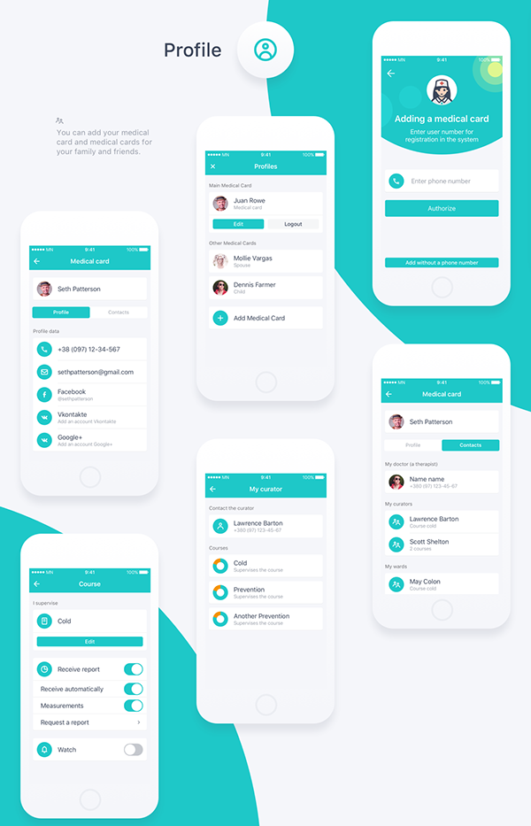
Challenges faced by Personal medical assistant.
Some patients will need to modify their lifestyle as part of the preoperative preparation for surgery and this can be challenging.
Older people preparing for surgical procedures may require additional support when they return home.
Medical assistants are trained to do a wide range of investigations to support clinical teams.
Most people having surgery experience a degree of anxiety.

Slide 9
1. in the past five years running up to the end of 2015, venture funding has grown 200%, allowing US $11.7 billion to flow into Health Tech businesses from over 30, 000 investors in the space.
2.The healthcare industry was (and in some respects)
is one of the least receptive
industries to technological developments –
only in 2010, 50% of US doctors
used pen and paper for patient records in the world.
Its growth trajectory in the medical grounds
Note:
Digital health represents the disruption to the healthcare industry that founders, investors and consumers alike are extremely keen to see visualized.

Slide 10

Overview of the Medicarebot
It is a type of a model which is useful in buying medicines as well as performing regular checkups
Consists of various tools which is useful in predicting the tests a patient should undergo
Helpful in booking an appointment through a hasslefree process.
Life tracking of Doctors
It works in 3 languages English Bengali and Hindi

Slide 11
Value Proposition
Handy and user-friendly, available freely.
Reduce healthcare wastage.
All sorts of information and guidance under one roof.
Shorter patient waiting times
Improved access in rural areas
Improved efficiency, leading to savings

Slide 12

Technologies used
Python
Machine Learning
NLP
Flutter
Dart
Firebase

Slide 13

Target Audience
People in the age group of 18-60.
People seeking medical facilities from their home.
People with disabilities.
Note:
Even for old aged people it will definitely make a positive impact in puchasing tests and medicines diectly from their homes.
Story for illustration purposes only

Slide 14
THANK YOU…..

